Slide 2
The use of e-solutions in payments processing
Ahti Bleive
Estonian Agricultural Registers and Information Board
27.07.17
Tartu, Estonia

Slide 3
Estonian Agricultural Registers and Information Board (ARIB)
State authority in the area of government of the Ministry of Rural Affairs.
ARIB is established in the summer of 2000 in Tartu.
Estonian Paying Agency
Duties
  - Administration of agricultural, fishery and rural development support schemes. National measures.
  - Implementation of EU agricultural market regulation measures
  - Keeping agricultural registers

Slide 4
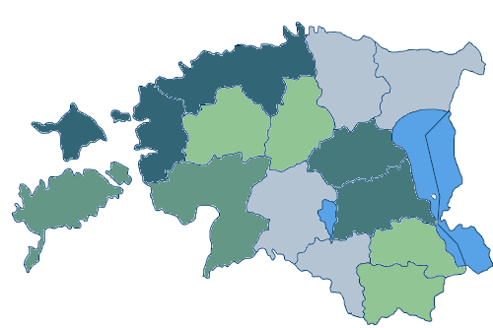
ARIB
Central Office in Tartu
7 regional bureaus
15 offices – 1 in every county
Ca 360-370 employees
2/3 of them in central Office
Relatively small number of
clients (farmers, entrepreneurs, animal
owners etc.), but also small number of employees
ARIB spends ca 3,5-5 € (total expenditure incl. investments), for paying 100€ of support

Slide 5
E - ARIB
Development of e-services started in 2005.
First services were developed for animal register (notifications from farmers to animal register).
E – applications for area and animal based supports from year 2008.
Every year additional functionalities for making submission of e-applications easier.
Year by year increase of e-applications. Important is, that e-applications are submitted mostly by farmers themselves.

Slide 6
General principles for applying area-based supports.
Application and additional documents can be submitted via e-ARIB.
Before the application period it is possible for applicants to draw fields and pre-fill application.
E-application system is mandatory for agri-environmental measures. ID-card or bank account is necessary to use e-ARIB;
Applicants must submit entire application each year (possible to use last year data).
After the application is fulfilled, applicant will have the information, if there are errors in his/her application and he/she can correct them before submitting it.
Submission is blocked if there are mistakes that are obviously not accepted.
Video guides https://www.youtube.com/watch?v=a9jd_foY3bI

Slide 7
Number of area-based applications

Slide 8
Total area of area-based applications

Slide 9

In 2012….
New programming period ahead,
new rules -> many changes
User and client expectations
Problems in ARIB
    Too many procedures/processes
    Too many different/duplicated IT systems
    Budget cuts
ARIB needed some changes, to survive the new period

Slide 10
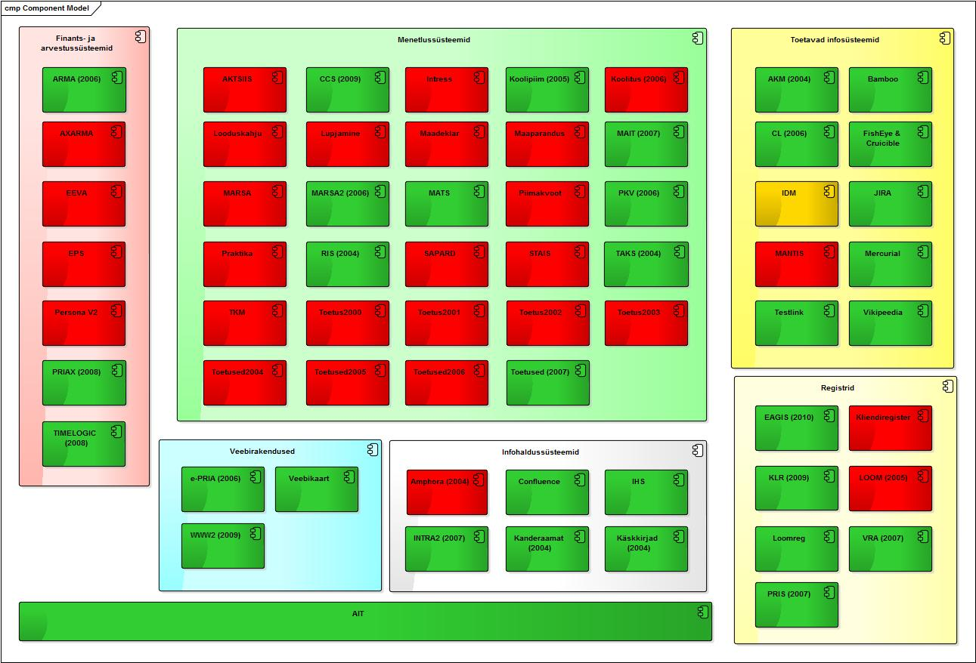
IT systems As-Is (2015)
Notes:
Ivo räägib siin sellest

Slide 11
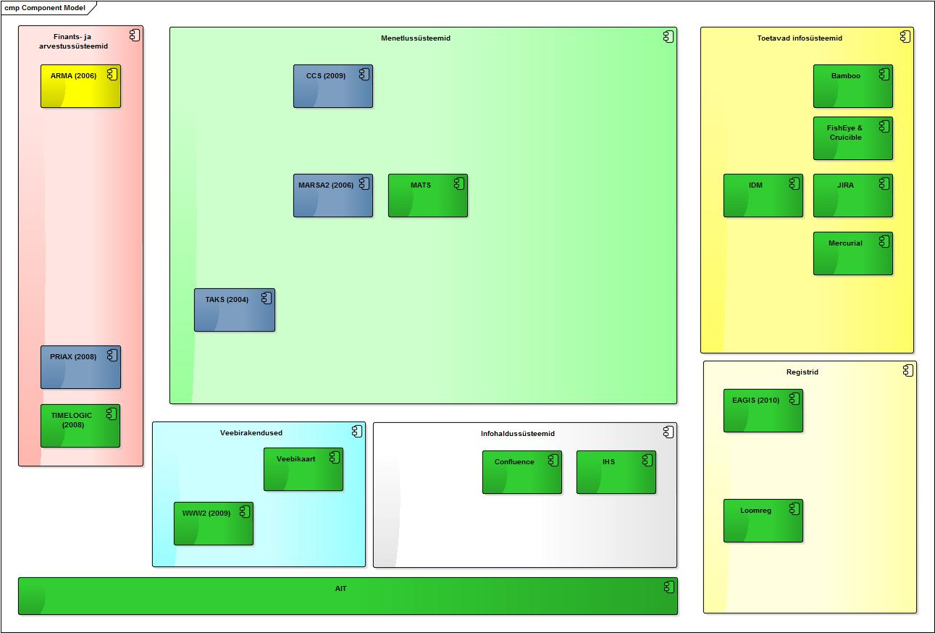
New challenges ahead – IT systems To-Be 2021?!

Slide 12
New goals in ARIB
2013 we updated our strategy and set new and ambitious goals:
faster management of claims (focus on investment measures)
paper-free management -> 100% use on e-services
increase in client satisfaction and employee commitment
better use of the budget
  No need for new employees
  IT system which is cheaper to maintain and change

Slide 13
First steps
Setting up program 2014+ and making plans for 2013-2016
Under program several projects dealing with business processes, risk management and development of new IT system
After tender in 2013 which brought us common software architecture within the ministry of Agriculture we chose 3 main IT development partners for next four years

Slide 14
E - ARIB2
From 2014 ARIB have 2 portals – one for direct supports (area-based and animal related supports) and animal register e-services (e-arib) and new portal for client registration and investment measures (e-arib2)
The first service for clients in e-ARIB2 was Price Catalogue for Agricultural Equipment – live oct 2014
The pilot measure was for Leader Action Groups – live oct 2014 – 100% e-applications!
2015 we have developed all standardized modules and measure-based specifications for the first important investment measure (1.4) – live 26.11.15
2016 Client register e-services
2016 10 more investment measures

Slide 15

E - ARIB2
e-ARIB2 is one new important tool achieving different business goals (faster management; paper-free management; etc)
part of ARIB-s new IT system MATS
customer focus
service-based architecture
flexibility - many configurations (we can set up the measure ourselves if there are not new requirements)
standardized and reusable components -> one portal for all support measures
100% e-services for clients
high level of automated controls (validations) - if rule-based requirements -> automated
many interfaces – information from other registers pre-filled for clients
high data quality
Notes:
Paindlikkus nõuetele

Slide 16
Long-term project plan for e-ARIB – one portal for all services!
2015
2016
2017
2018
2019
2020
6 investment measures + Leader measures + TA
Client register
IACS+ RDP animal-related + area-based measures
ohter RDP measures (non-IACS) + national schemes
Fisheries measures
Animal register

Slide 17


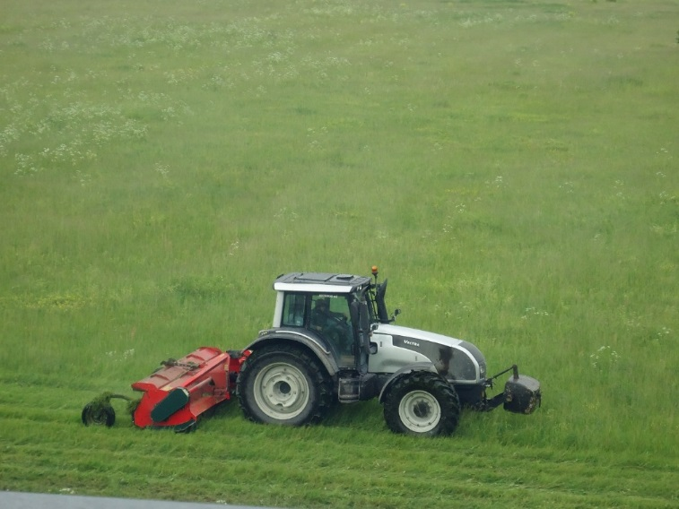
SATTELLITE BASED
MOWING
DETECTION

Slide 18
BACKGROUND
Mowing or grazing of grassland by certain date is one of the most common requirements for all area based supports in Estonia.
Mowing requirement is quite often violated. This is keeping error rate high.
On the spot checks are done only for 5-6 % of applicants.
Cost of on the spot checks is rising every year.
There is a need to reduce number of on the spot checks and to have better targeted field inspections.
Preventing errors is better than sanctioning.

Slide 19
PRE-DEVELOPMENTS AND RESEARCH BASIS
Research and preparatory projects started in 2011.
Main research and development partner: Tartu Observatory.
SAR-based projects: 2011, 2013 and 2015, using TerraSAR-X, RADARSAT-2, COSMO SkyMED and Sentinel-1 data.
Optical data projects: 2012 and 2013, using VHR and HR satellite data from WorldView, QuickBird and Spot.
Encouraging satellite based results, well in line with field inspection results!

Slide 20
DEVELOPMENT OF MOWING AND GRAZING DETECTION SYSTEM “SATIKAS“
Country level operational mowing detection service is at the moment in development and testing phase.
Reporting the mowing detection results (mowing dates) to the farmers and paying agency officials.
Combining Sentinel-1 and Sentinel-2 time series and meteorological data.
Development years: 2016-2017.
Full testing 2017 (pilot). Results will be represented in October at PA’s Directors Conference.
Service fully operational starting from 2018.

Slide 21



PROJECT TEAM
Estonian Agricultural Registers and Information board – service user, definition of requirements.
Tartu Observatory – science partner, mowing detection scientific calculations.
CGI Estonia – software development partner, software development and integration tasks.

Slide 22
SYSTEM OPERATING PRINCIPLE

Slide 23
OPERATIONAL SYSTEM
Field borders from PA GIS database.
Support application and farmers data from IACS.
Due to input data resolution (10-30 m) constraints, system covers fields greater than 0.1-1 ha (corresponding to ca 98 % of the grasslands area in Estonia).
Input data temporal density: new image every 2 days.
Update of “mowing layer“ at least every week
Weather independence thanks to Sentinel-1 radar data.
Notes:
The core idea of the methodology is to employ interferometric coherence from Sentinel-1 andthe normalized difference vegetation index (NDVI) from Sentinel-2 for detection of mowing events.

Slide 24
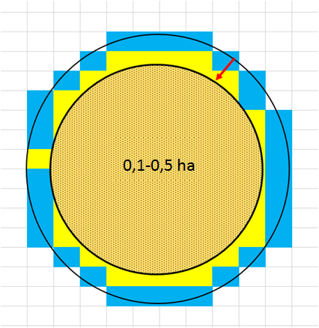
MINIMUM SIZE OF THE SURFACE
Buffer area (mixed pixcels) 9-10 m
Minimum area for calculatying (optimal is to set minimum 0,1-0,5ha)

Slide 25
REMINDERS TO THE FARMER
The system will notify the farmer when they have two weeks until deadline of mowing.
Reminders are sent via e-mail or text message.
Reminder includes reference
link to the web map.

Slide 26
RESULTS ON WEB MAP

Slide 27
RESULTS IN FARMERS PORTAL

Slide 28
RESULTS IN IACS

Slide 29
NEXT STEPS
Crop (crop group) detection functionality will be added to SATIKAS during 2018.
Cooperation and exchange of information with external parties – Azercosmos, Planet, ESA, ohter PA’s, Learning Network etc.
Other possible functionalities (and other possible image providers) will be assessed during 2017:
Detection of nitrogen fixing crops
Detection of cultivation of fallow land
Hints for changes in LPIS.

Slide 30
NEXT STEPS 2
New initiatives from behalf of European Space Agency and European Commission (JRC). We are very interested to participate in pilots.
Results from EU Paying Agency Directors conference. Proposal to replace IACS with IAPS (integrated administration and prevention system).
We have to look wider than just remote sensing and sentinel data to have new innovative error prevention and control methods.
Continuous development of E - ARIB

Slide 31
THANK YOU FOR ATTENTION!
Ahti.Bleive@pria.ee

